Slide 1
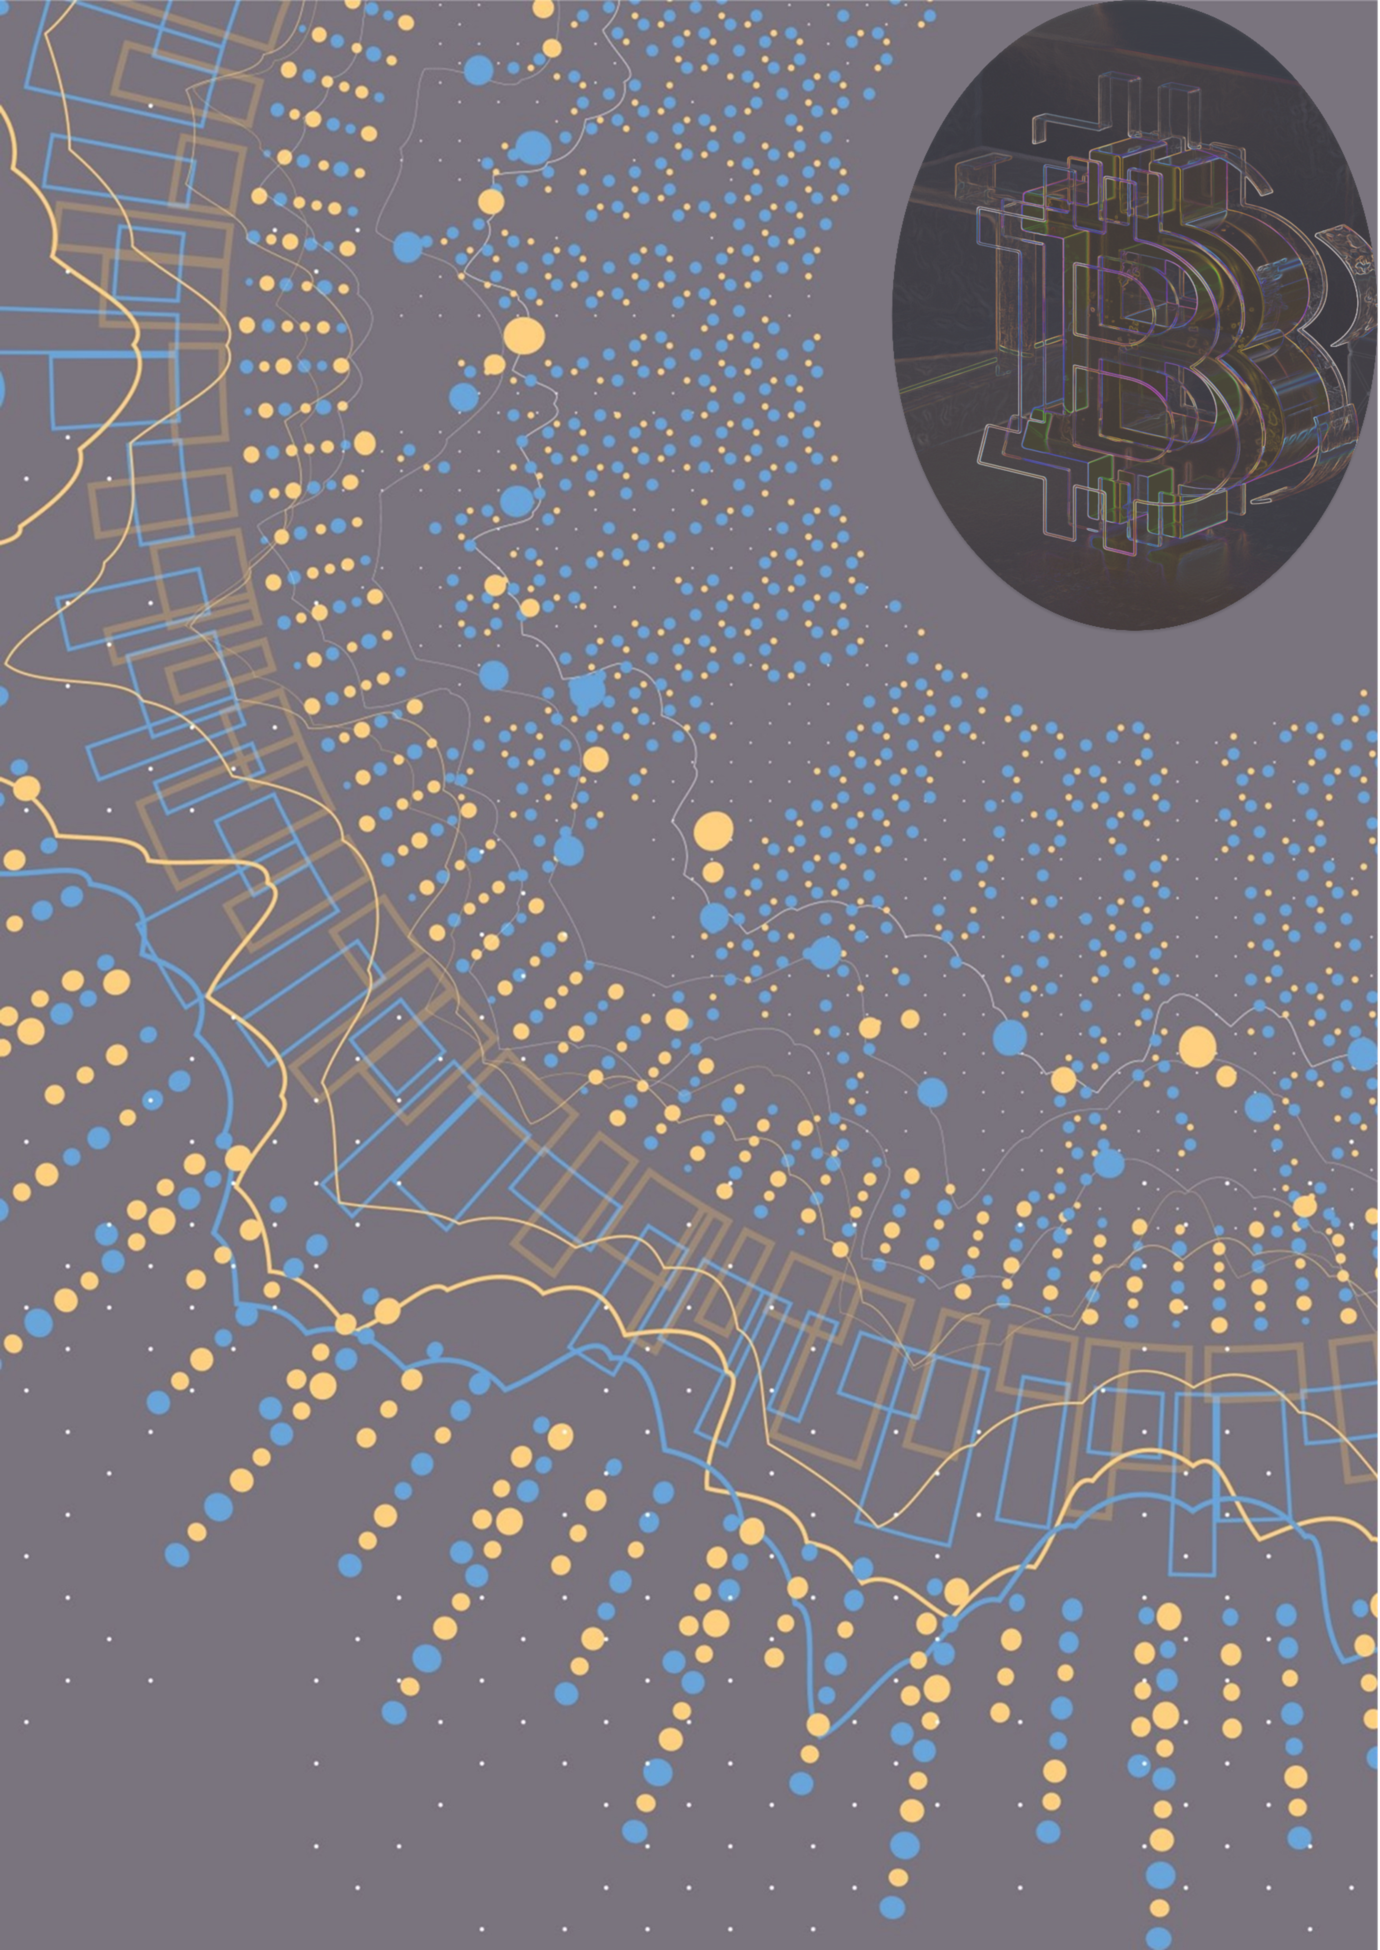

















Punto Banco Crypto
Algorithm
Trading
BTC
ETH
BNB
XRP
LTC
…………
ADA
DOGE
USDT
USDC
Scam Crypto
Reward
Reinforcement
Learning
Env
State
Agent
Action
Casino
WIN!

